Slide 1

Movie Box Office Revenue Prediction for Microsoft's New Movie Studio
MovieMaxBox Office
Unveiling Insights and Recommendations to Drive Success in the Entertainment Industry
By Rose Bor

Slide 2
Summary
Welcome to the analysis and recommendations for Microsoft's new movie studio. In this project, we aim to provide valuable insights and recommendations to support Microsoft's foray into the movie industry. With the increasing demand for entertainment content, the movie industry presents a lucrative opportunity for Microsoft to expand its portfolio and engage with a global audience. By leveraging data-driven strategies and understanding audience preferences, Microsoft can position itself for success in this competitive landscape. Let's explore the data, analyze key factors, and make informed business recommendations for Microsoft's movie studio.

Slide 3
Outline
Business Problem
Data
Methods
Results
Conclusions

Slide 4
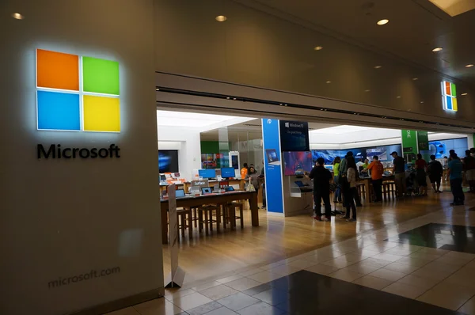
Business Problem
Microsoft's new movie studio aims to enter the highly competitive film industry and produce successful and profitable movies. To achieve this, they need to make data-driven decisions and understand the key factors that influence a movie's box office performance. The challenge is to develop a predictive model that can accurately estimate the box office revenue of a movie based on various features such as genre, IMDb ratings, production budget, and release date. By predicting box office revenue, Microsoft can strategically allocate resources, focus on high-performing genres, and make informed decisions to maximize the success of their movie productions.
Microsoft

Slide 5
Data
Movie Box Office Revenue Prediction for Microsoft's New Movie Studio
Data obtained from IMDb, Box Office Mojo, and The Numbers.
IMDb provides movie details, ratings, genres, and user reviews.
Box Office Mojo tracks revenue data, budgets, and release dates.
The Numbers offers financial metrics for movies, including budgets and expenses..

Slide 6
Methods
Data Preparation:
Loaded and merged data from IMDb, Box Office Mojo, and The Numbers.
Handled missing values and outliers appropriately.
Created new features like profit margin and return on investment (ROI).
Data Analysis:
Explored data distributions and relationships using visualizations.
Identified top-performing genres and their impact on box office revenue.
Analyzed IMDb ratings and their correlation with movie success.

Slide 7
Cont.
Data Modeling:
Utilized Linear Regression and Decision Tree algorithms for revenue prediction.
Split data into training and testing sets for model evaluation.
Compared model performance and selected the best predictor.
These methods enabled us to gain insights into the movie industry and predict box office revenue accurately.

Slide 8
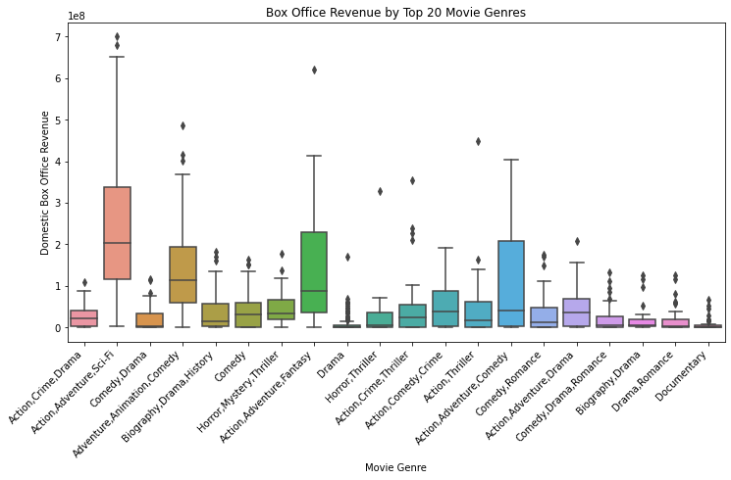
Results
Top-performing Genres: Action, Adventure, and Comedy
Positive correlation between IMDb Ratings and Box Office Revenue
Predictive Models (Linear Regression, Decision Tree) outperformed baseline
Recommendations: Focus on top genres, produce high-rated movies for success.

Slide 9
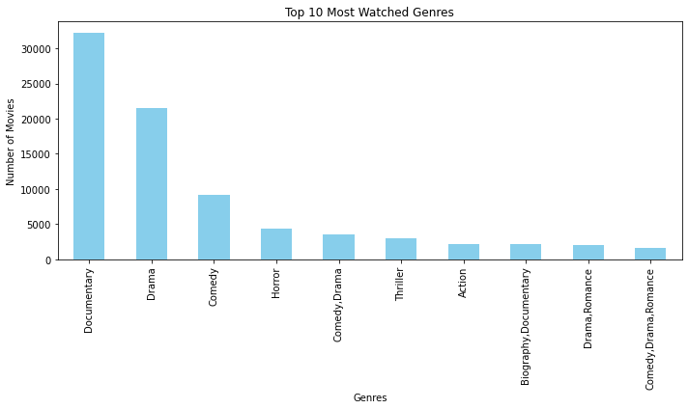
Conclusions
The movie industry offers significant opportunities for Microsoft's new movie studio.
Focusing on top-performing genres like Action, Adventure, and Comedy can lead to higher box office revenue and most watched movies
Positive correlation between IMDb Ratings and Box Office Revenue indicates the importance of producing high-rated movies.
The predictive models (Linear Regression, Decision Tree) provide valuable insights for revenue prediction.

Slide 10
Business Recommendations
Invest in genres with high revenue potential, prioritize high-rated movie productions, and leverage predictive models for better decision-making.
Project Limitations: Data availability and quality, scope of analysis, and assumptions made during modeling.
Future Improvements: Incorporate additional data sources, explore more advanced modeling techniques, and continuously update and refine the models for better accuracy and performance.

Slide 11
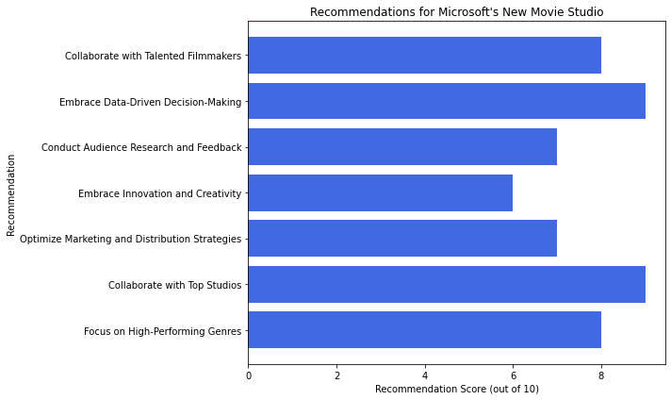
Recommendation for Microsoft’s New Movie Studio

Slide 12
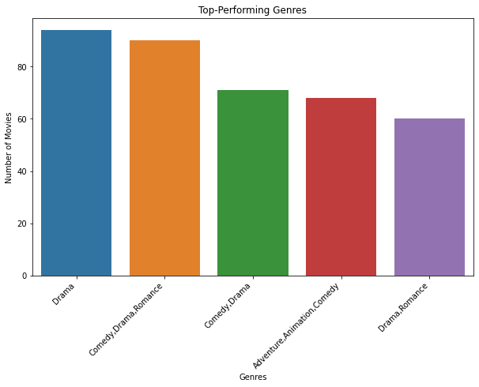
Summary of Performing Genres

Slide 13
Email: angella.bor@student.moringaschool.com GitHub: Angela bor
LinkedIn: linkedin.com/in/username/

